Slide 1
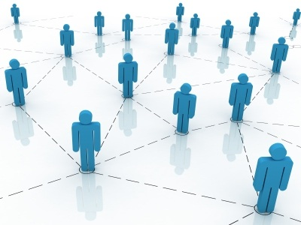
Why should we care about Social Network Analysis?

Slide 2
What is Social Network Analysis?
… the layman’s version
A self-organizing
map of relationships
A UNIVERSE!
Own terminology
Own modelling strategies
Own theory

Slide 3
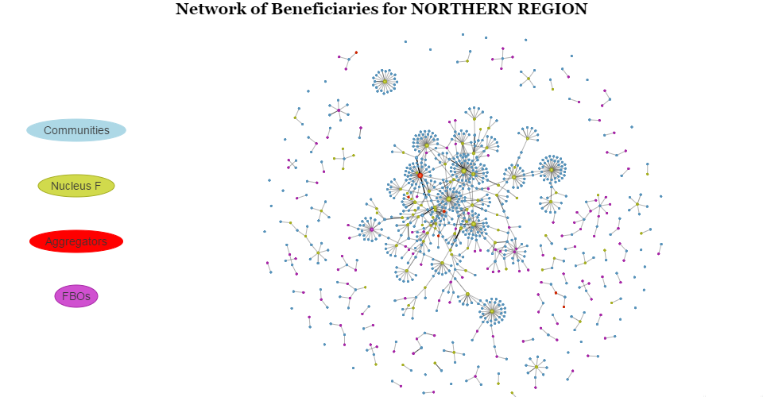
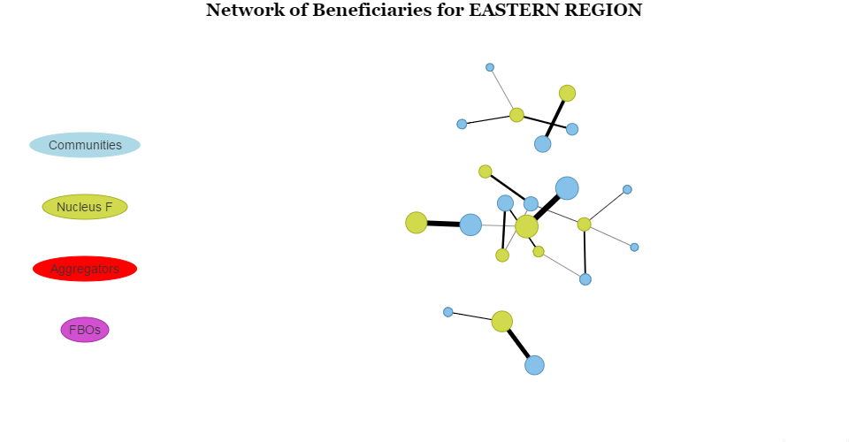
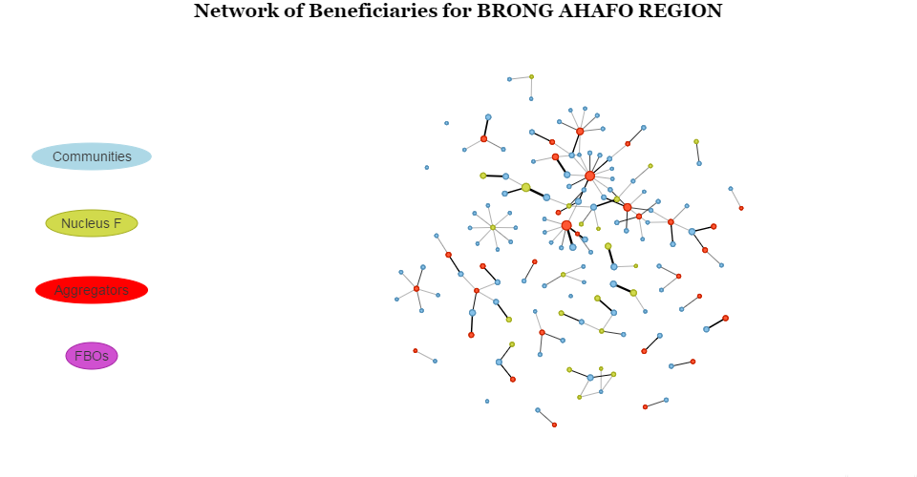
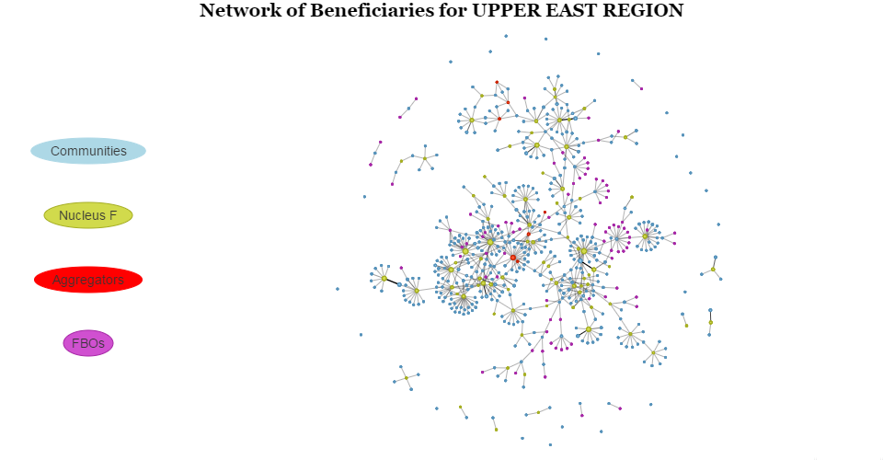
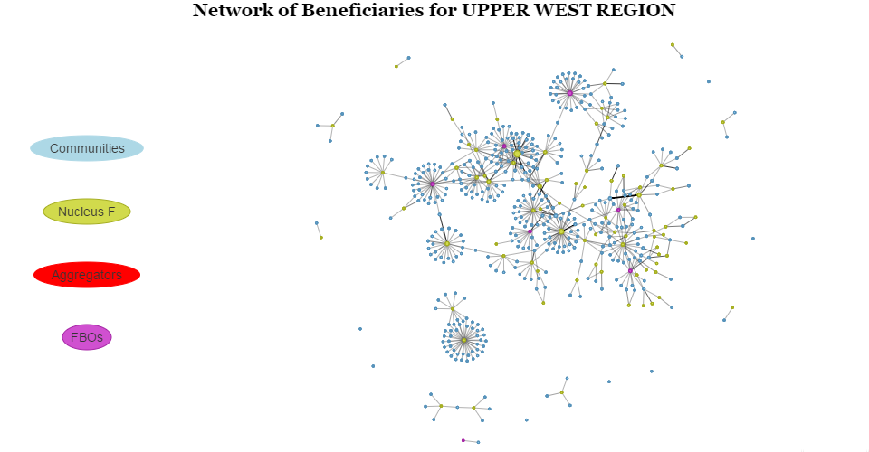
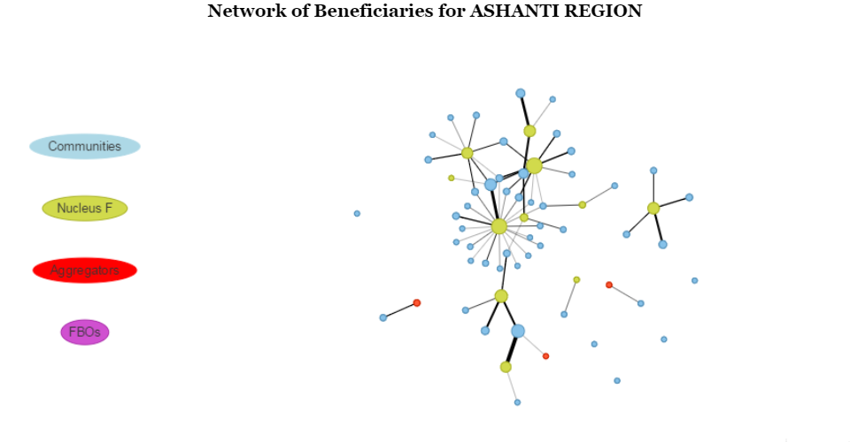

Slide 4

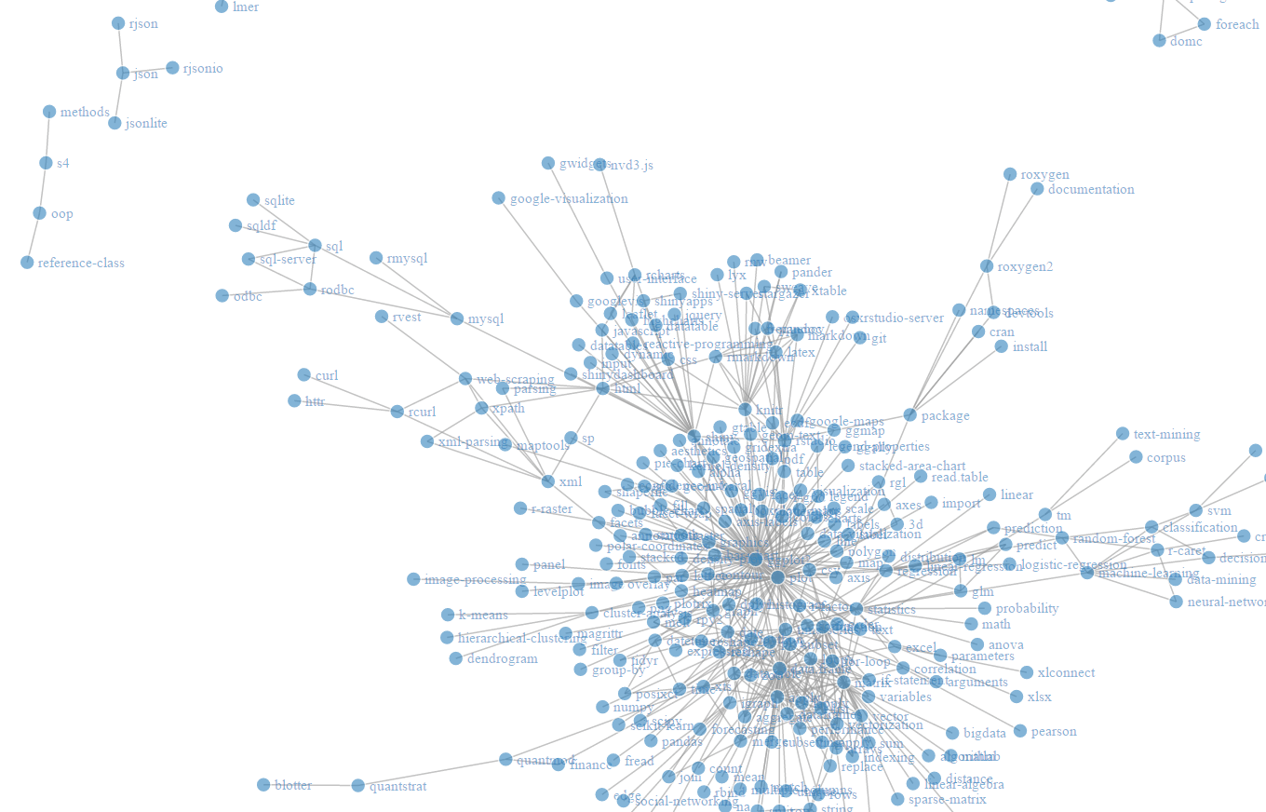
Some examples

Slide 5
How can we use it?
Look at INDIVIDUAL NODES or
the WHOLE NETWORK

Slide 6
Node Centrality
(Betweenness centrality, Closeness centrality, Eigenvector centrality, Degree centrality…)
Less important
Producer A
Sales 1000
Important
Producer B
Sales 900

Slide 7
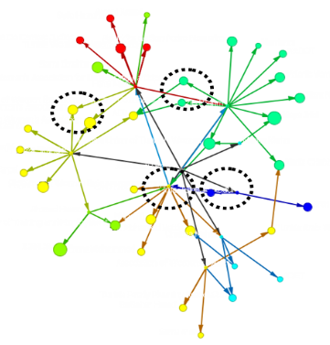
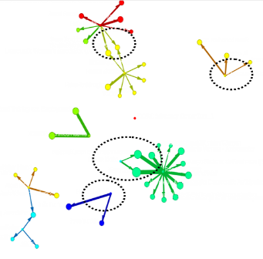
Network Fragmentation
Pre-Intervention
Post-Intervention

Slide 8
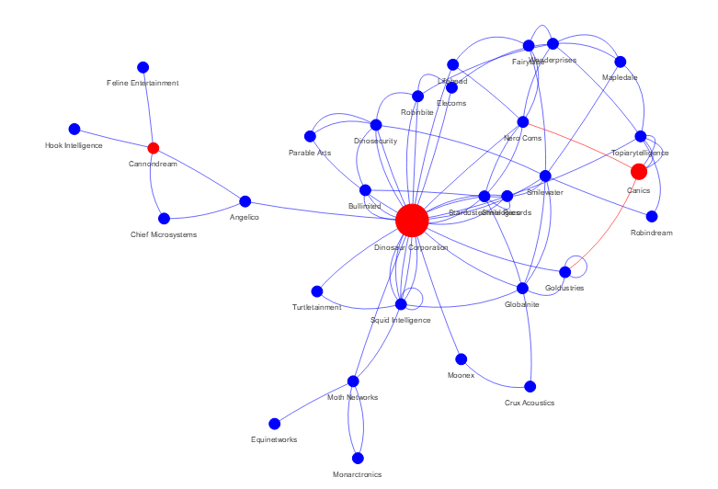
Resolving the “bottleneck”
Bottleneck
Create new
connections

Slide 9
SNA is NOT simple…
… but that doesn’t mean we can’t start off simple…
Tool Demo

